Slide 1
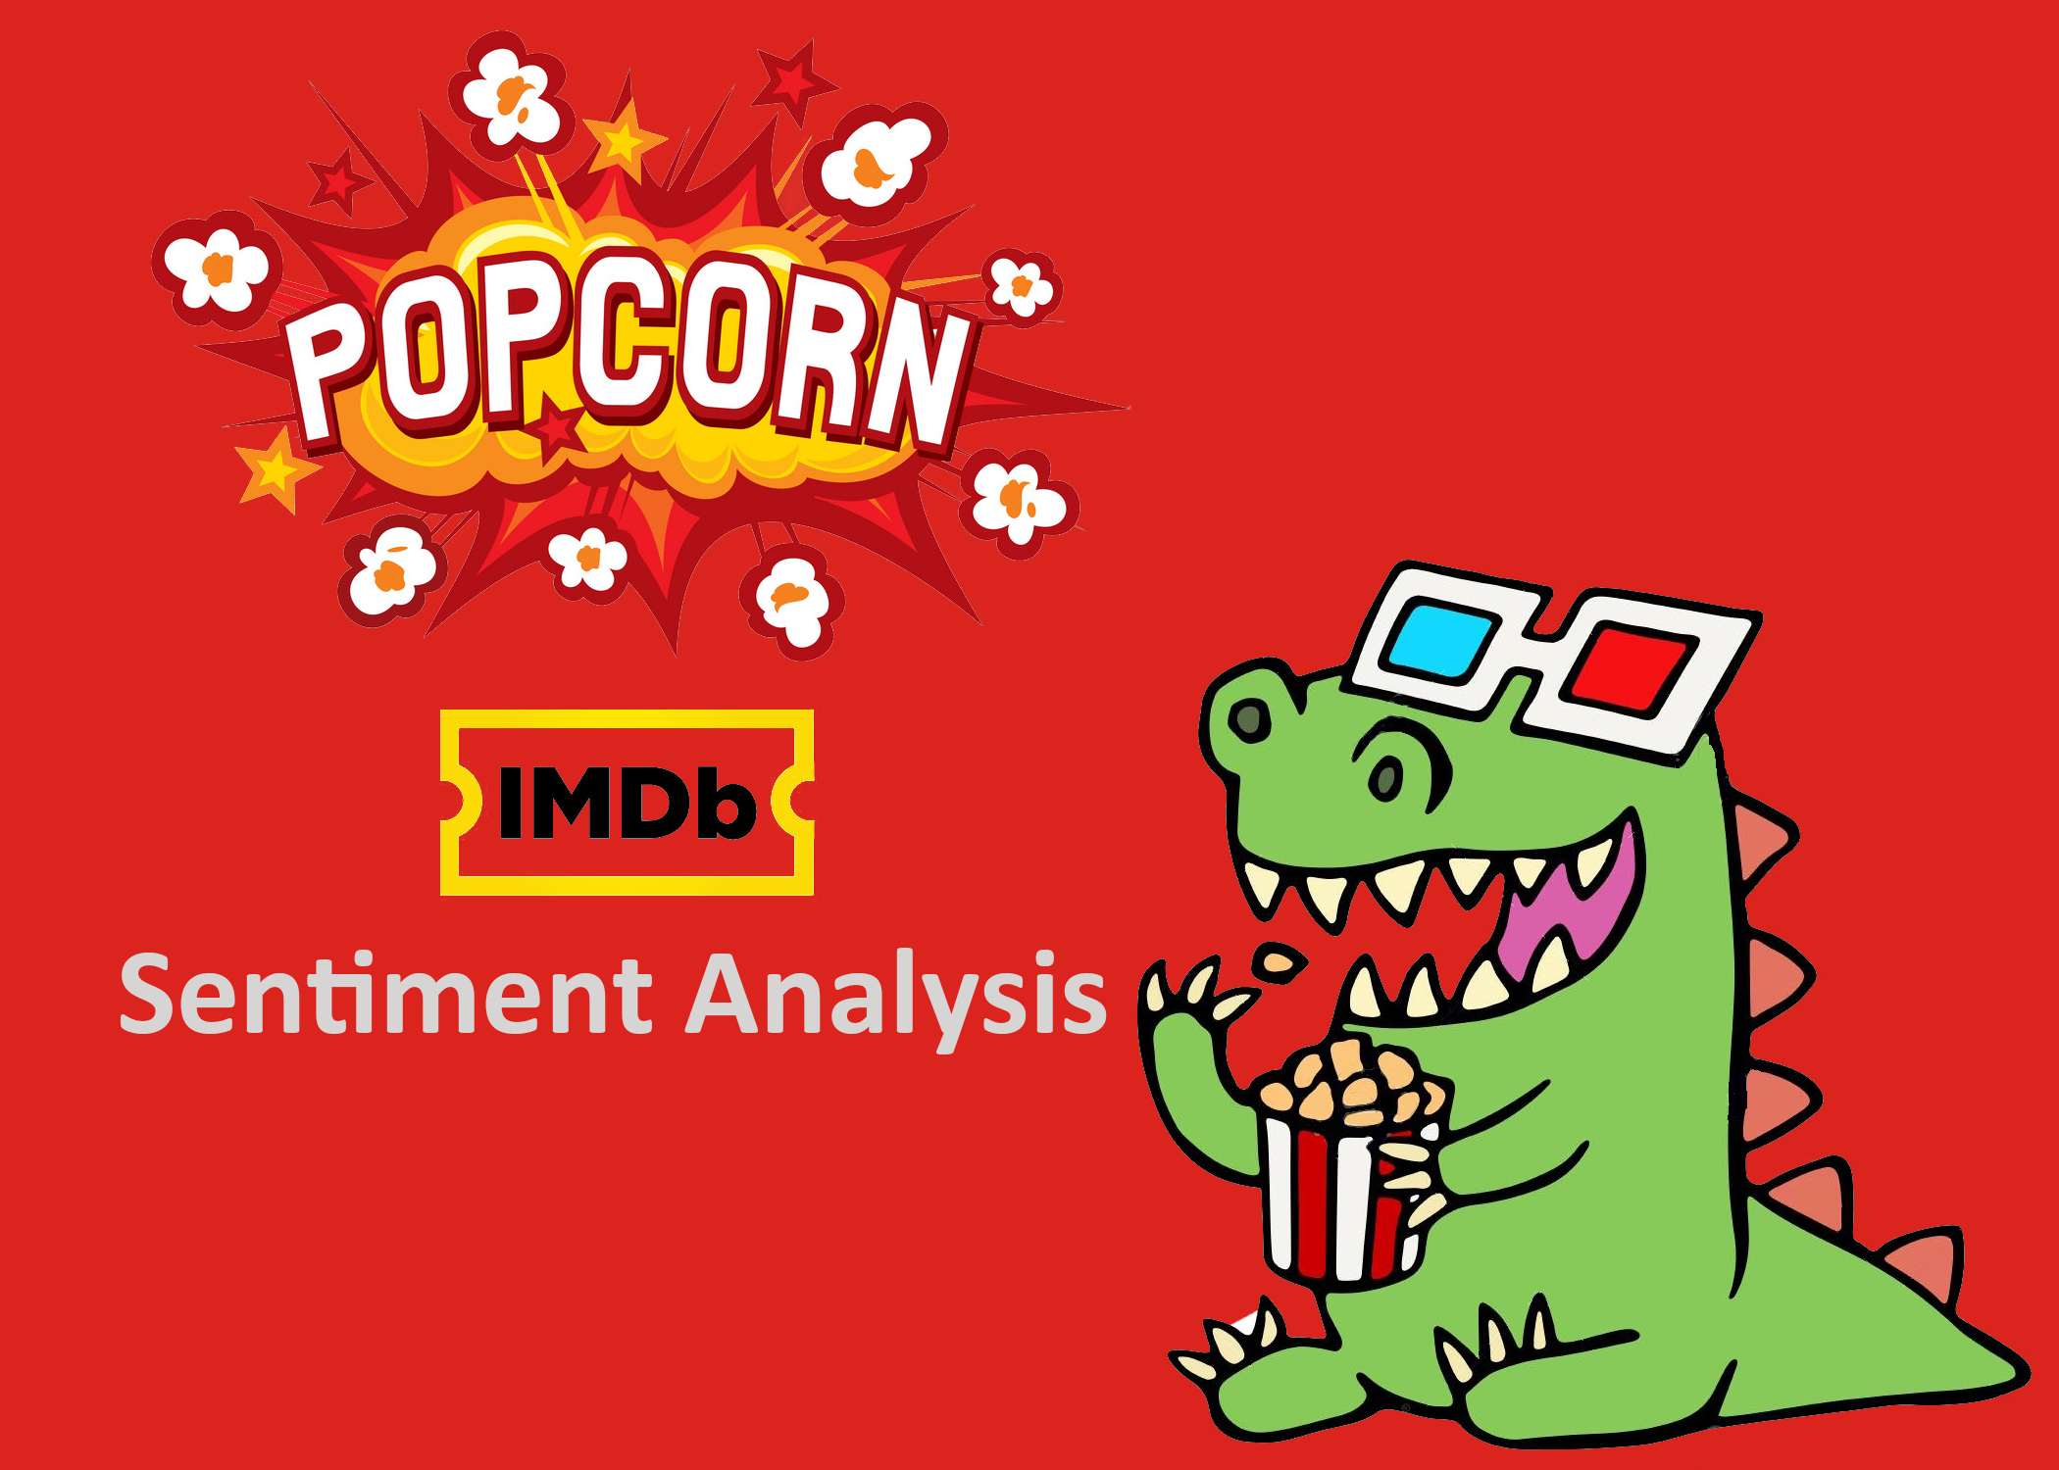


Slide 2

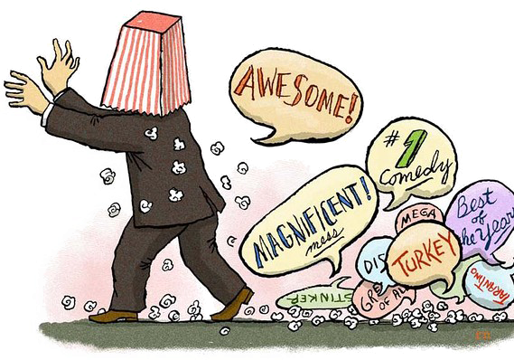
What are we working on: The problem to be addressed!
Mediocre movie
Mega disaster
Movie not fantastic

Slide 3
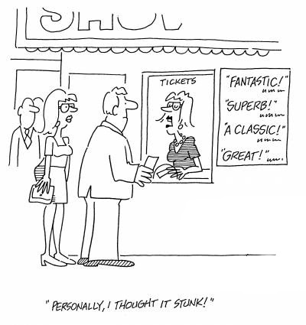
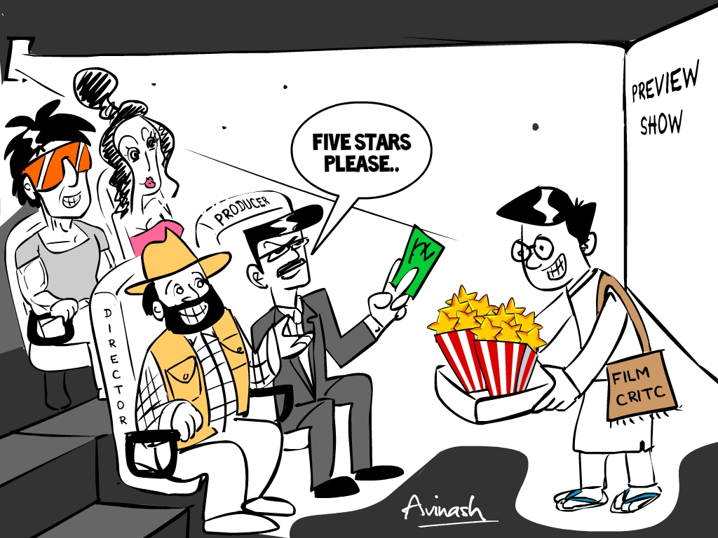
Why is it interesting?
• 81% of Internet users (or 60% of Americans) have done online research on a product at least once.
• 20% (15% of all Americans) do so on a typical day.
• consumers report being willing to pay from 20% to 99% more for a 5-star-rated item than a 4-star-rated item (the variance stems from what type of item or service is considered).

Slide 4
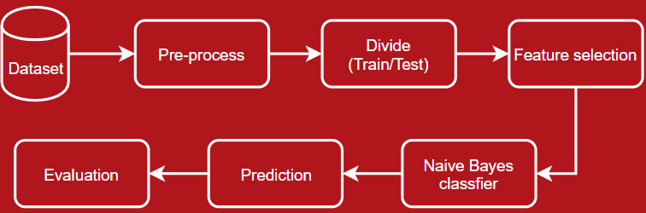
Approach

Slide 5
Approach
Create Dataset
Pre process
  Data cleanup
Feature Selection
  Divide the data in 2 features – positive and negative
Classifiers
  Naïve Bayes
    10-fold cross validation
  Review sentiment
    Positive/Negative
  Evaluation
    Check the result against the result from the standard library

Slide 6
Dataset Creation
Selecting IMDB’s 20 highest rated and 20 lowest rated movies as the base movies list, rated by IMDB users.
Performing a DFS crawl on the webpages to extract 100 movies from each base movie.
Generating a total of 1329 movies ready for generating movie reviews from users.

Slide 7
Dataset Creation
Storing the movie reviews using their IMDB ids. Example. : ‘tt0022304’
Forming urls for movies using the base url which leads to the movie’s review page. Base Url: http://www.imdb.com/imdb_id/tt2574698/
Extracting 20 reviews and corresponding rating by the same user from every movie.
Using Beautiful Soup and html tags for extracting the required data.

Slide 8
Dataset Creation
Storing all the reviews into a dictionary where the review is the key, rating the value. Example: { ‘I love the movie’ : ’10’}
Calculating the average user movie rating from the above dictionary.
The value was 6.5904
Hence, considering ratings from 1-6 as negative, 8-10 as positive. Segregating into negative and positive reviews based on this data. 7 rating is considered as neutral ratings, which are not included in the dataset.
Collecting 6000 positive and 6000 negative reviews in .txt format for every review.

Slide 9
Pre-processing Data
All the reviews are preprocessed using the following techniques:
Removing stop words: using nltk(“stopwords”)
Removing stems from words using PorterStemmer from nltk
Removing punctuations using string.punctuations
Pushing the reviews into a csv file along with the polarity (0 or 1)
Repeating the same for generating bi grams. Using ‘_’ to append two unigrams for generating the bigrams.

Slide 10
Naive Bayes Implementation
Tokenize reviews
Number of occurrence of each unique word
  In all positive reviews
  In all negative reviews
  In all the reviews
Prediction
  Tokenize review
  For each token
    # occurrence(token) in review * P(hypothesis)

Slide 11
EVALUATION
Support Vector Machine (SVM) classifier
Multinomial Naïve Bayes classifier
(scikit-learn machine learning library)
The main focus will be on text mining problems: term frequency and inverse document frequency (tf-idf)
Process Division:
  1. Feature extraction process
  2. Training the classifier

Slide 12
EVALUATION
Tf-Idf weighted Word Count Feature Extraction: How?
build the vocabulary of the corpus
generate word count vector from each file
The Problem?
Frequently occurring words present in all files of corpus irrespective of the sentiment, like in this case, ‘movie’, ‘acting’, etc will be treated equally like other distinguishing words in the document.
Stop words will be present in the vocab if not processed properly.
Rare words or key words which can be distinguishing will not get special weight.

Slide 13
PERFORMANCE EVALUATION
K-cross fold validation (10)
Comparison between (MultinomialNB and SVM) based on:
Conventional Word count
Tf-Idf weighted factor
Comparison between:
scikit-learn machine learning library: Multinomial NB and SVM(Linear)
Naive Bayes (custom implementation)

Slide 14
References
Dataset creation : http://www.imdb.com/
Data pre-processing :
https://www.nltk.org/
https://tartarus.org/martin/PorterStemmer/

